Slide 1
SQL Retail Analysis
Fauzia Y. Ayupuspita

Slide 2
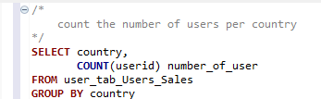
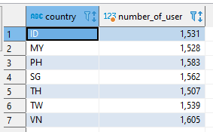
Question 1 & Table Result
Question 1
Write an SQL statement to count the number of users per country

Slide 3
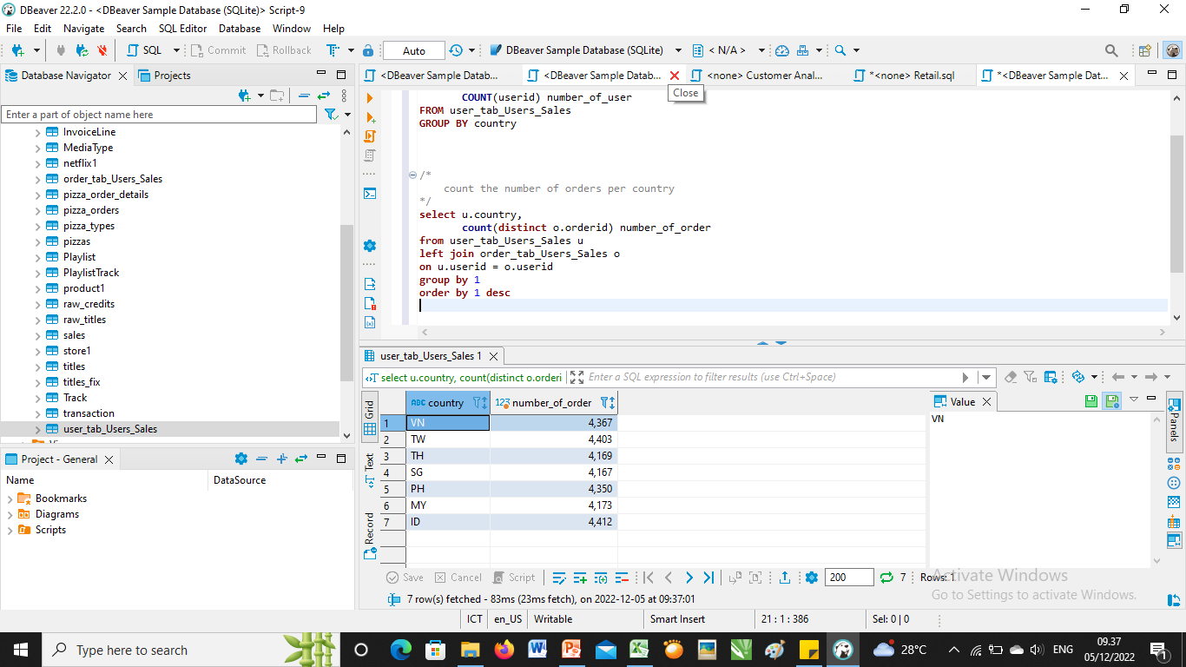
Question 2 & Table Result
Question 2
Write an SQL statement to count the number of orders per country

Slide 4
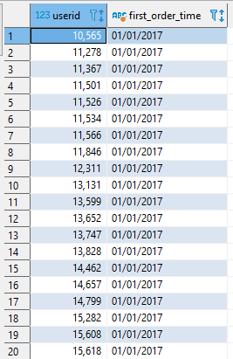
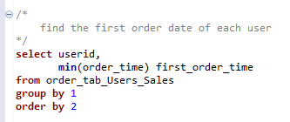
Question 3 & Table Result
Question 3
Write an SQL statement to find the first order date of each user

Slide 5
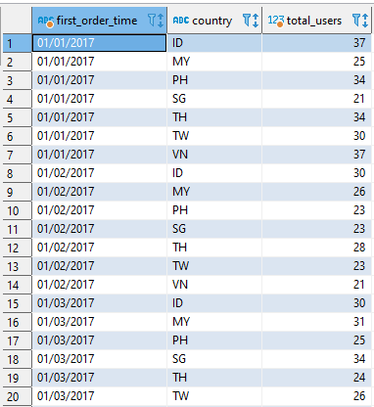
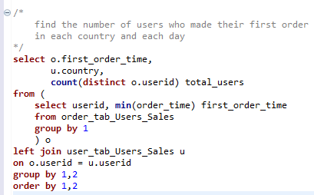
Question 4 & Table Result
Question 4
Write an SQL statement to find the number of users who made their first order in each country, each day

Slide 6
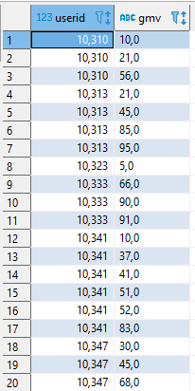
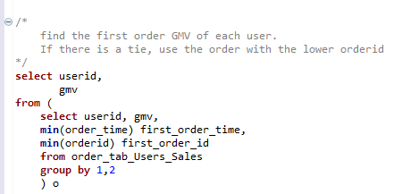
Question 5 & Table Result
Question 5
Write an SQL statement to find the first order GMV of each user. If there is a tie, use the order with the lower orderid

Slide 7
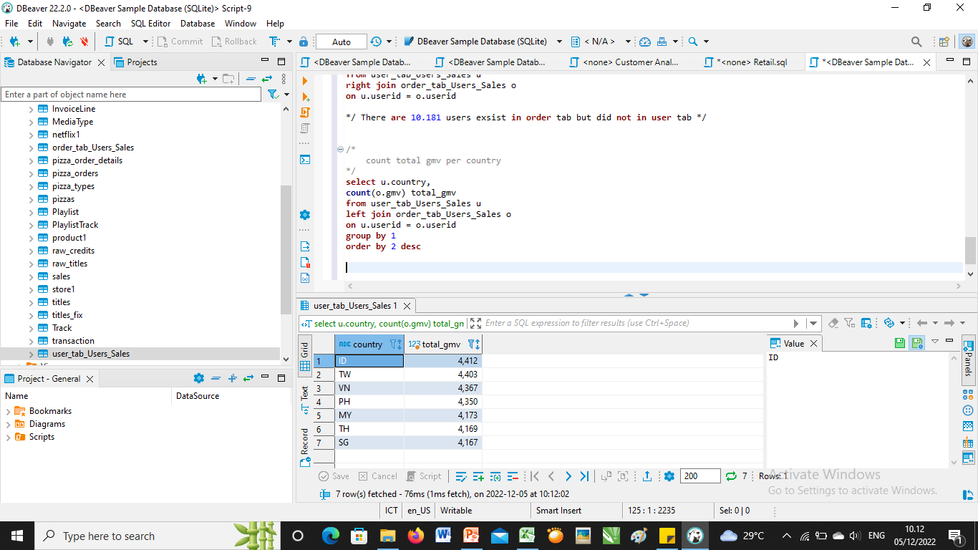
Question 6 & Table Result
Question 6
Write an SQL statement to find the total GMV per country

Slide 8
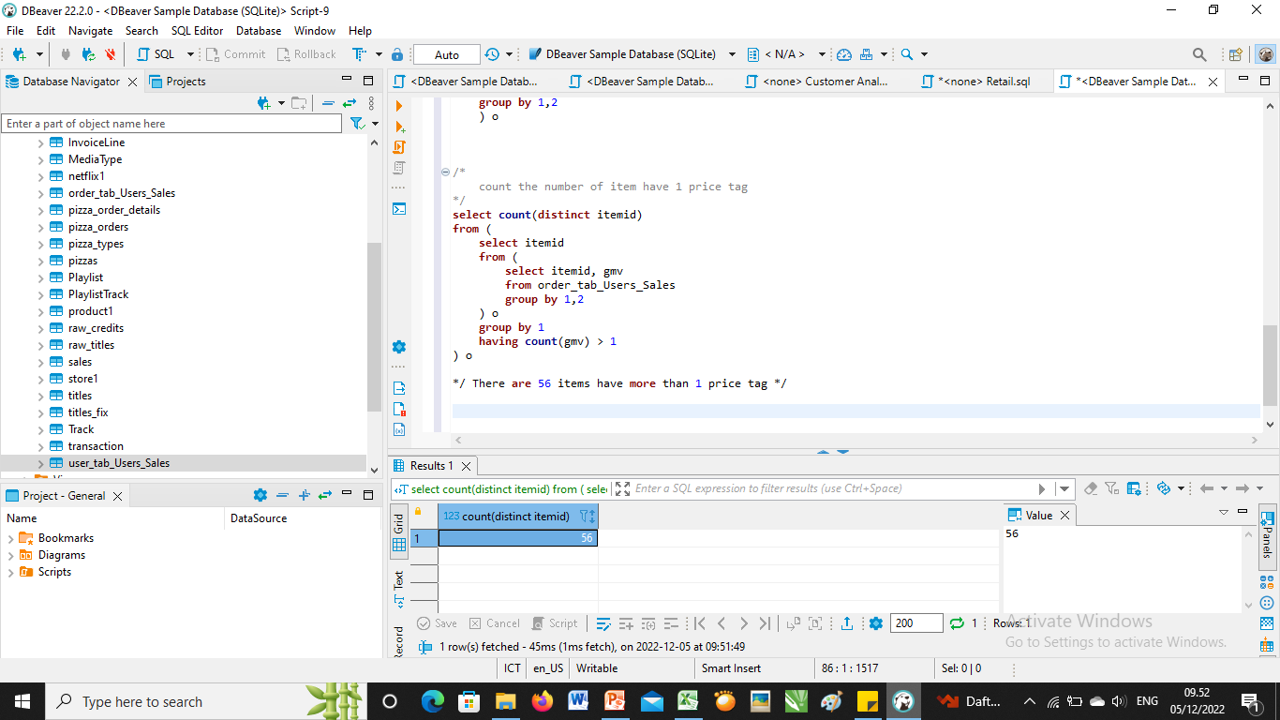
Question 7 & Table Result
Question 7
Find out what is wrong with the sample data

Slide 9
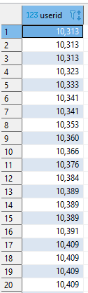
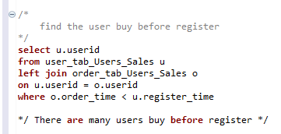
Question 7 & Table Result
What is wrong with the sample data
There are many users buy before register

Slide 10
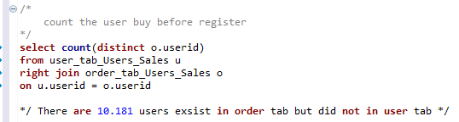
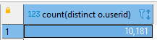
Question 7 & Table Result
What is wrong with the sample data
There are many users buy before register

Slide 11
Conclution
ID is the highest GMV given, because ID is the first country to open branches
There are several problems we should fix, such:
Many items have more than 1 price tag
many users buy before register

Slide 12
THANK YOU

